Slide 1
Integrating Engineering Design in the Middle School Science Curriculum
Manufacturing Video Guide

Slide 2
Are you ready to be an engineer?
In your science class, you designed and manufactured a Soap Box Derby mini-car.
Now let’s see how manufacturing works in the “real world”!

Slide 3
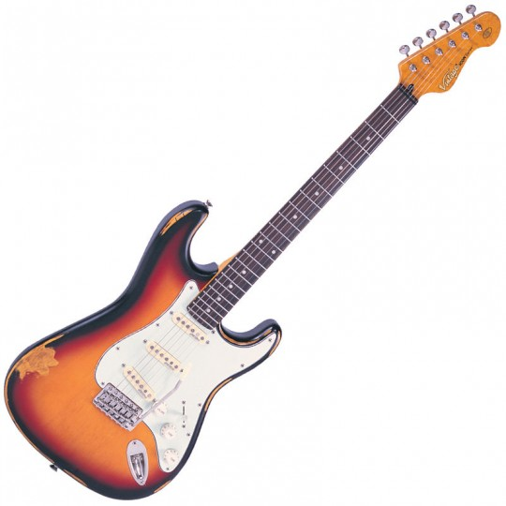
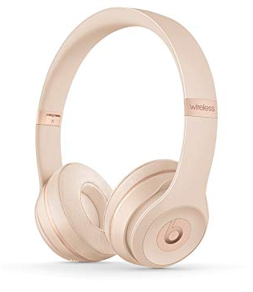
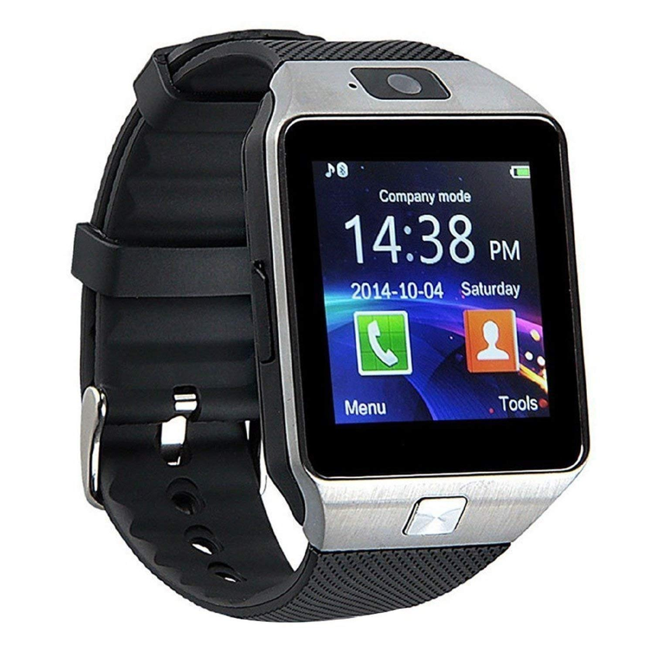
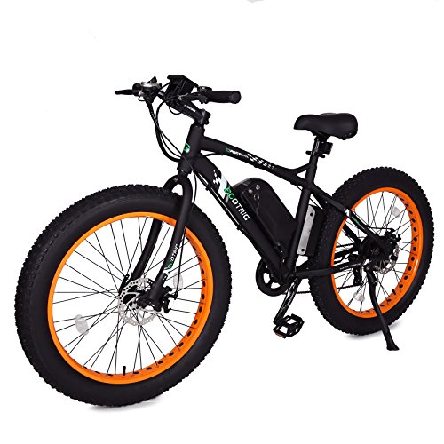
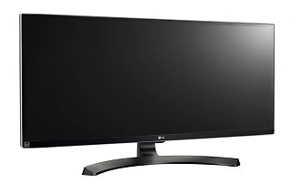
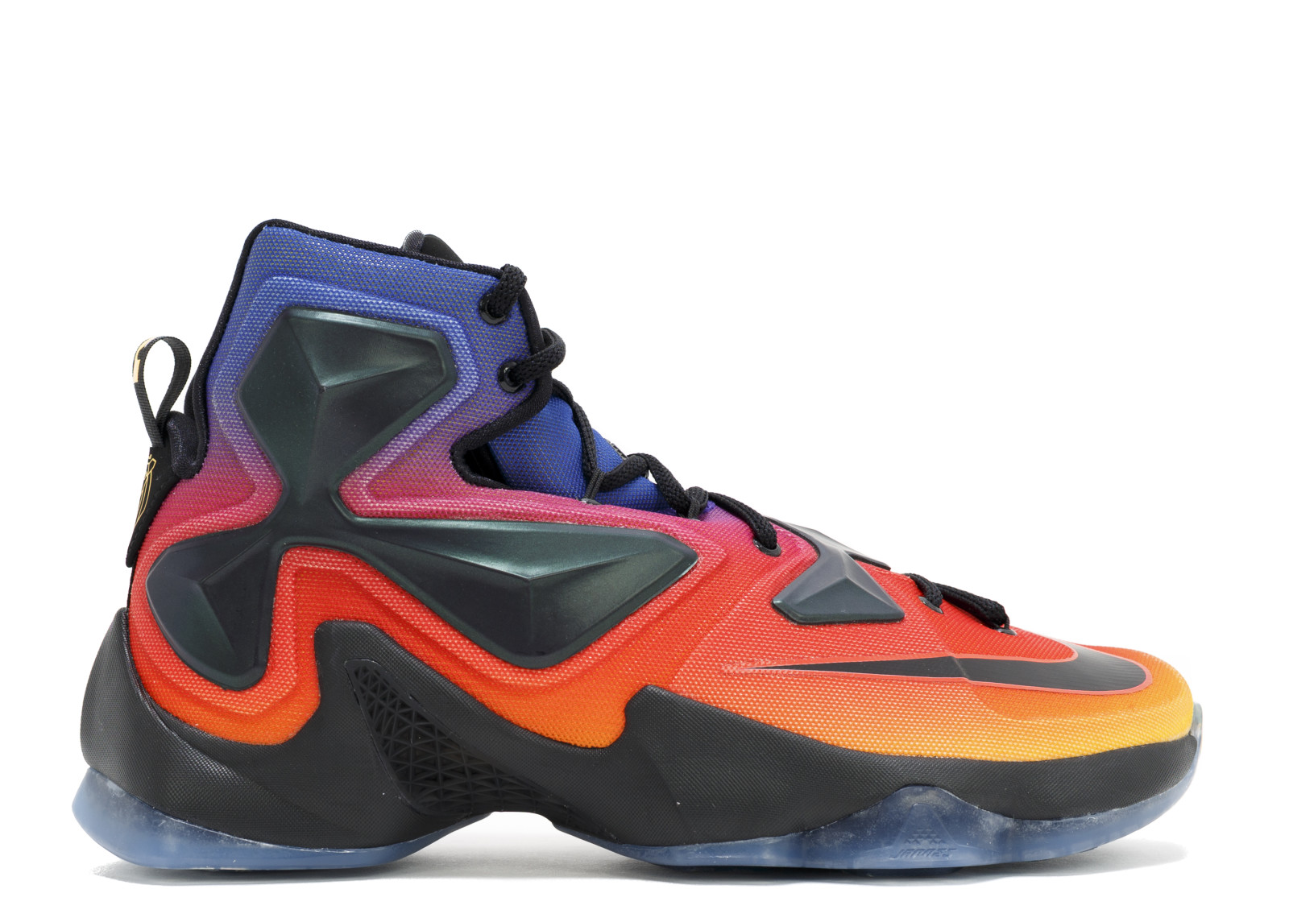
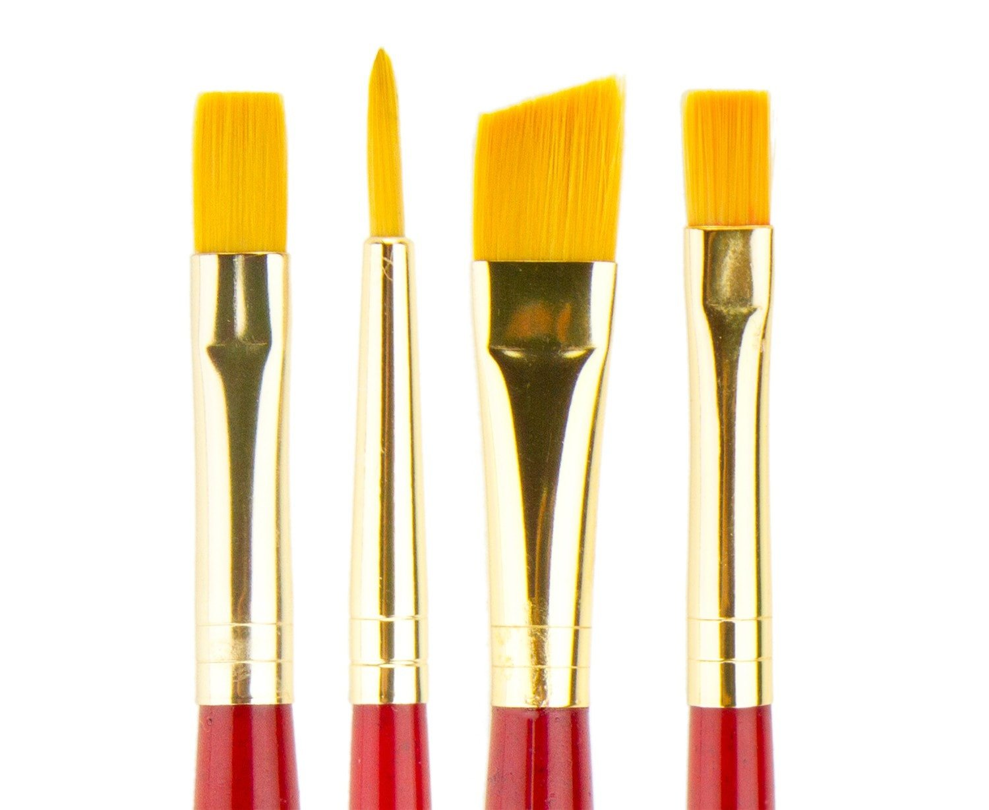
Think about Manufacturing
What is a favorite item you own?
What do you think goes into making these items?

Slide 4
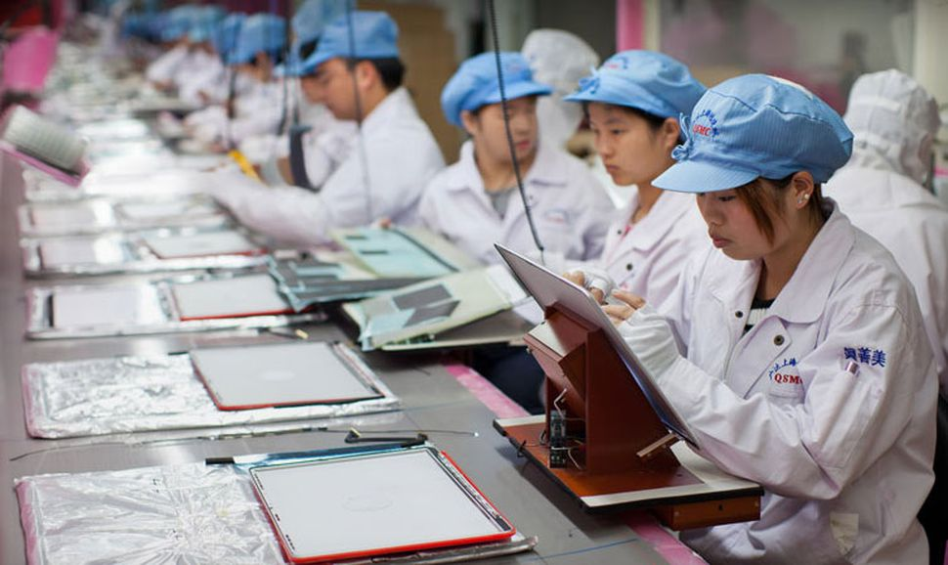
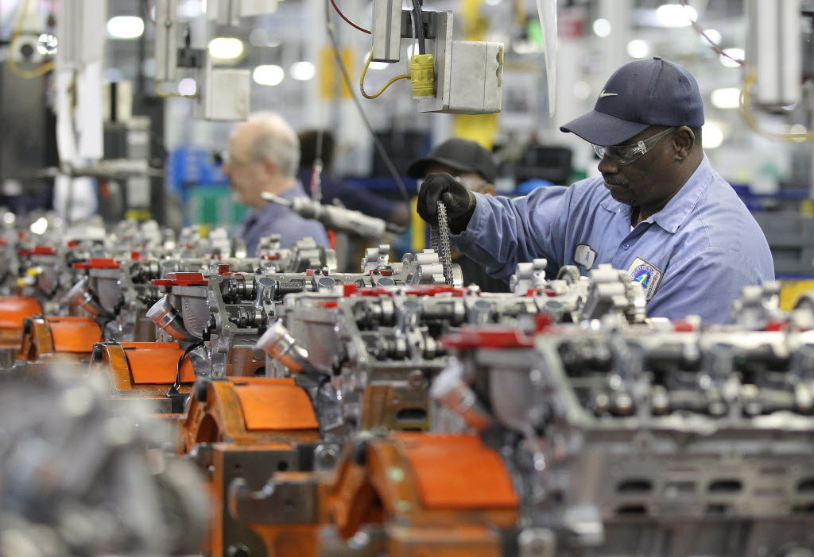
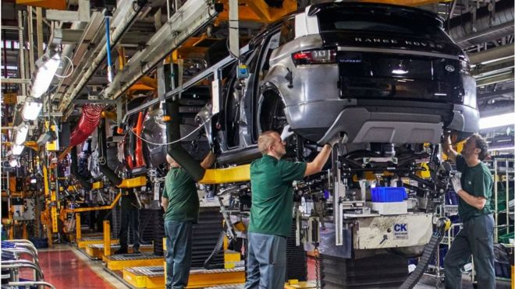
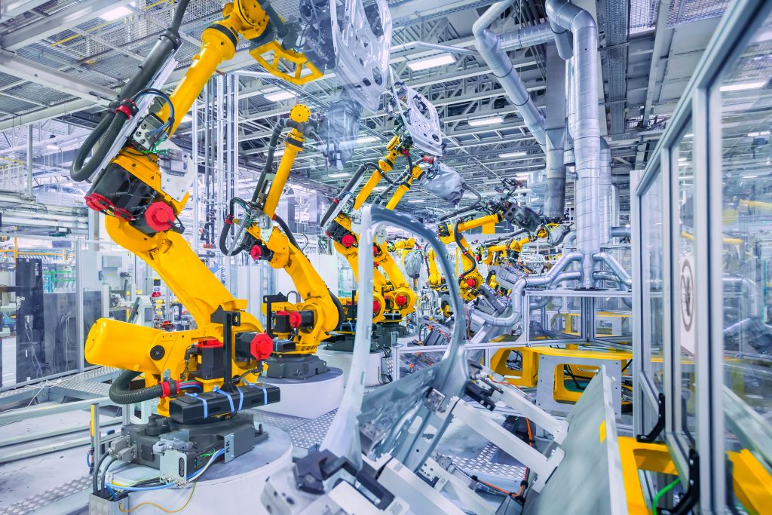
Think about Manufacturing
Manufacturing follows the same general process for making all items: someone or something follows instructions to produce what is desired

Slide 5
Video Introduction
Watch this video to learn:
The importance of manufacturing
How to prepare yourself to contribute to this broad and growing field
After the video concludes:
Reflection questions
Engineering design examples
Local company spotlight
Video on next slide:

Slide 6
https://www.youtube.com/watch?v=bJ6oG2ixHZw
Notes:
https://www.youtube.com/watch?v=bJ6oG2ixHZw

Slide 7
Video Reflection
What did you learn about the field of manufacturing from the video?
Why might someone be interested in manufacturing or engineering as a career?
Why do you think engineering or manufacturing may be a rewarding career?

Slide 8
Video Reflection
To pursue a career in engineering or STEM, several pieces of advice were given. What one or two things that were mentioned were most impactful to you?
Did you notice any similarities to what you learned, and the skills mentioned in the video?
You’ve seen one example of using the Engineering Design Process to make something better. How else might you use this process to make something better?

Slide 9
Engineering Design Examples
The following slides showcase the Engineering Service Design Team at The University of Akron.
Made up of students committed to engineering a better community.
Promotes teamwork and applications of engineering to develop solutions to aide nonprofit community organizations.
http://esdtua.wixsite.com/service

Slide 10
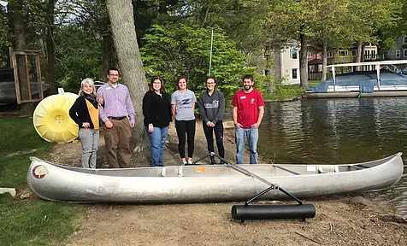
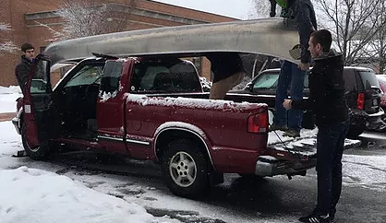
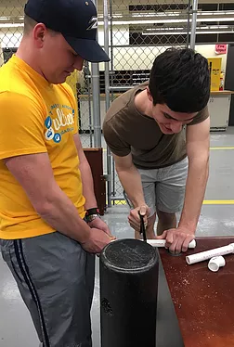
Akron YMCA Rotary Camp Canoe
Project: To design a canoe for Akron's YMCA's Rotary Camp with a removable device to keep the canoe from tipping over in the water.
The brackets holding the canoe together were 3-D printed. The prototype design was tested several times in the University of Akron's pool. The finished outrigger was used by campers at the Rotary Camp during the summer.

Slide 11
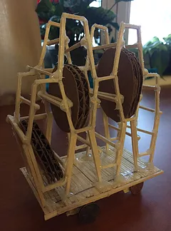
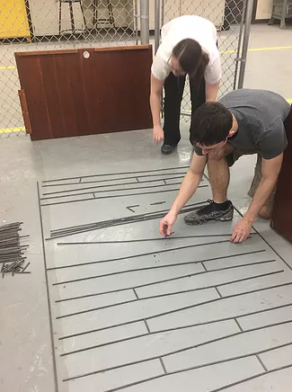
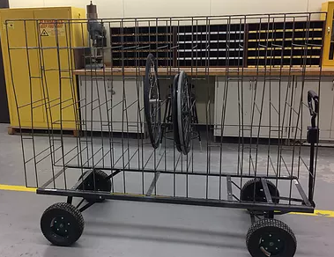
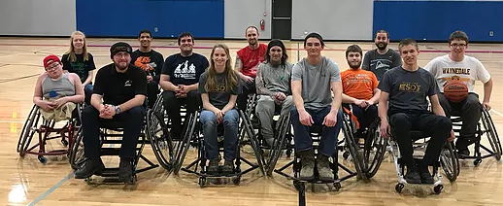
ASPO Wheel Cart
Project: To design and build a cart for Adaptive Sports Program of Ohio that can store and transport multiple wheels for racing wheelchairs. The wheels come off the chairs for easier transportation between events.
The design considered saving space, ease of use, and durability, including a honeycomb design and space for 18 wheels. The finished wheel cart will be used to transport equipment to competition for ASPO’s basketball, rugby, and track wheelchair teams.

Slide 12
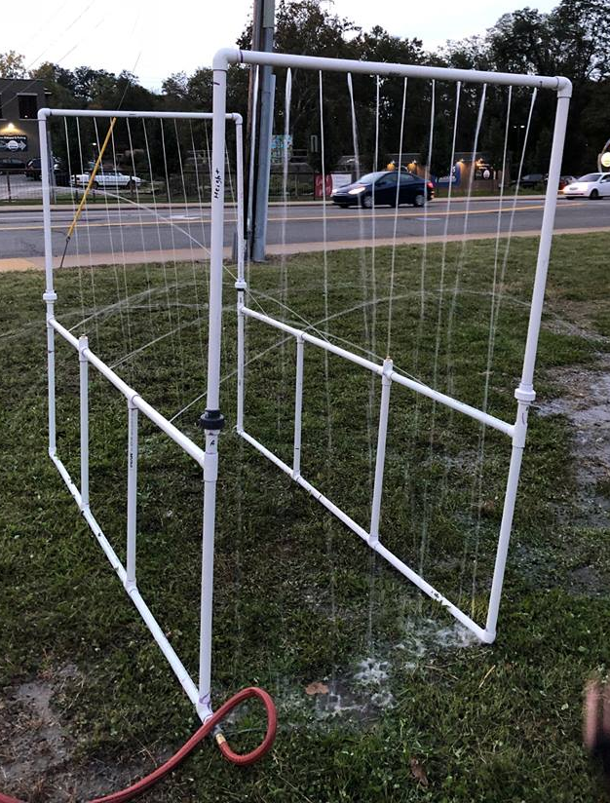
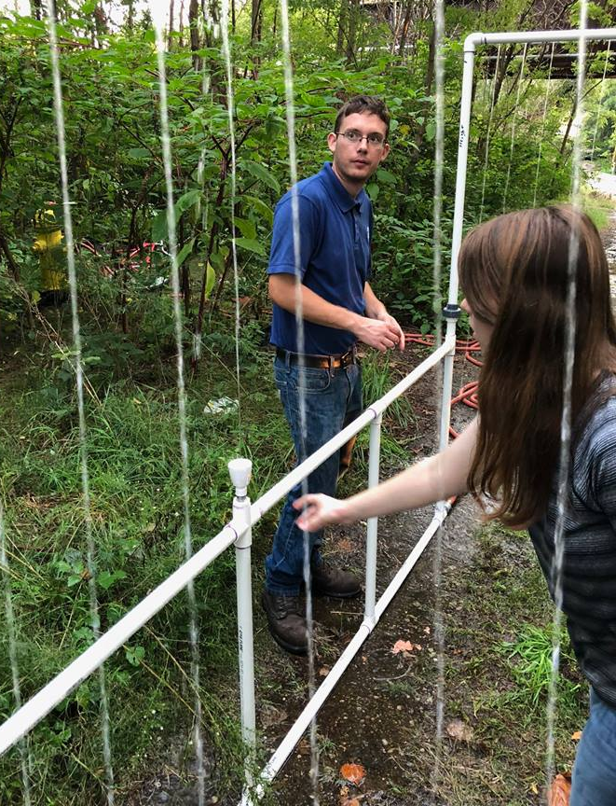
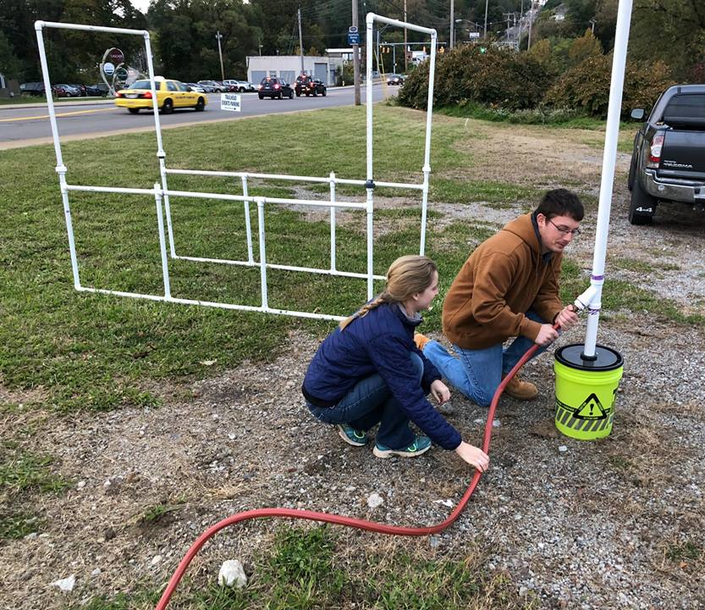
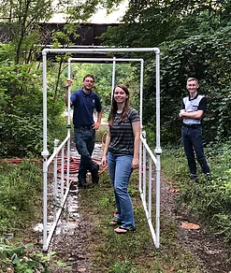
Akron Portable Splash Pad
Project: To assist Akron artist Mac Love in designing several portable splash pads for Akron neighborhoods. The team has built and tested their models. This is one of several art installations around Akron.

Slide 13
Local Manufacturing Companies
The following slides showcase local manufacturing companies that had employees featured in our video.
These companies contribute to the following statistics:
Ohio ranks 3rd in number of manufacturing jobs available across US.
Manufacturing jobs make up over 12% of all jobs in Ohio.
From the Ohio Manufacturer's Association
www.ohiomfg.com

Slide 14
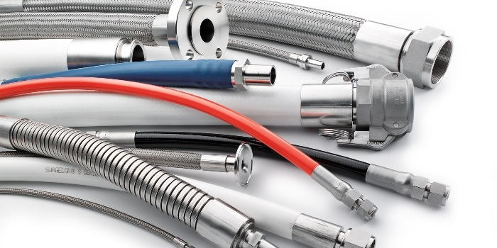
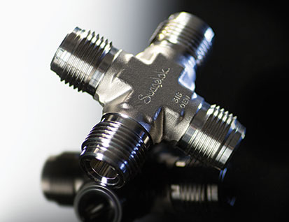
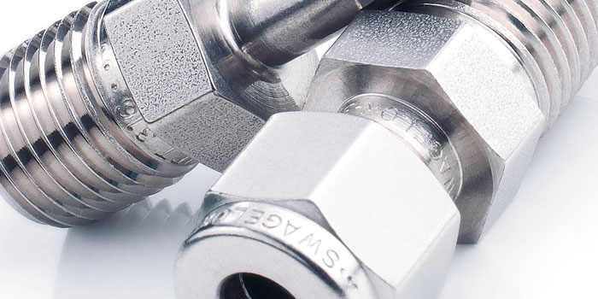
Solon, OH
Engineering Focus:
Control flow of liquids and gases through tubes and pipes
www.swagelok.com

Slide 15
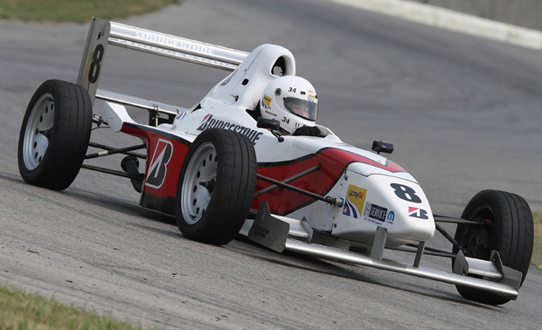
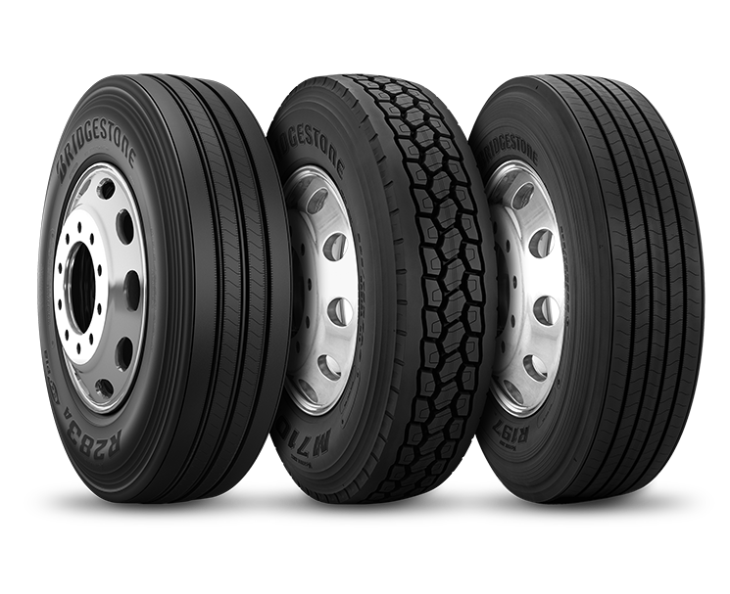
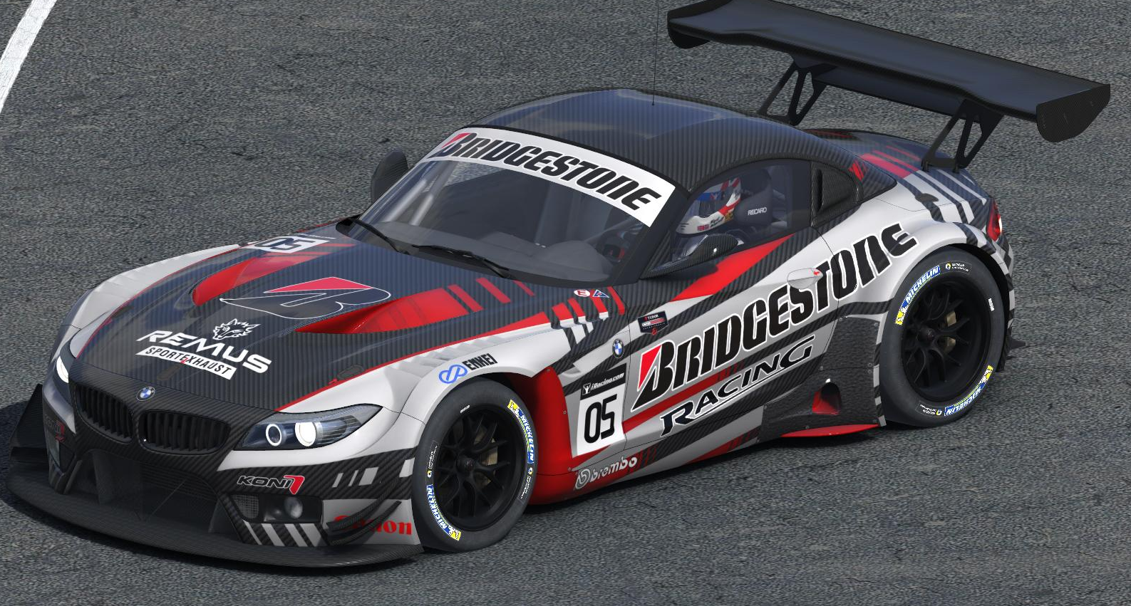
Akron, OH
Engineering Focus:
Tires for automobiles, trucks, aircraft, motorcycles, race cars
www.bridgestoneamericas.com

Slide 16
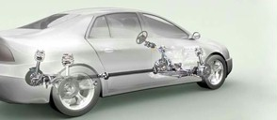
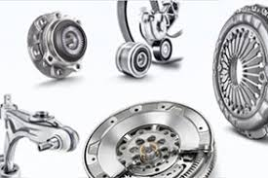
Wooster, OH
Engineering Focus: Automobile bearings for cars and industry
www.schaeffler.com

Slide 17
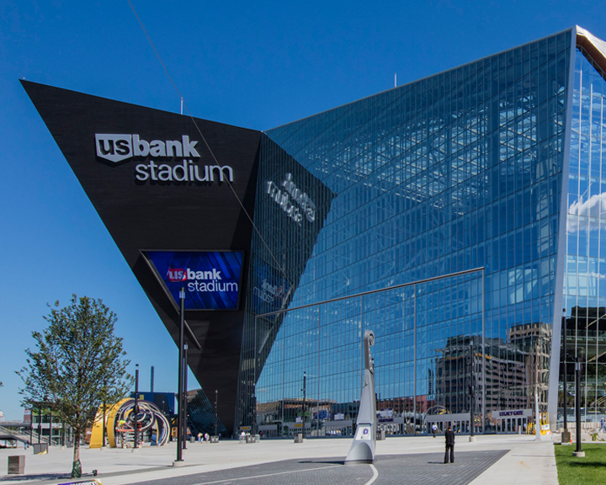
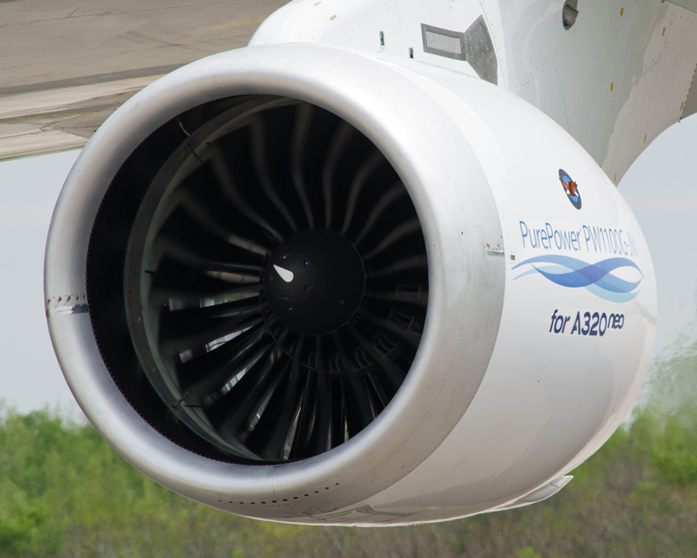
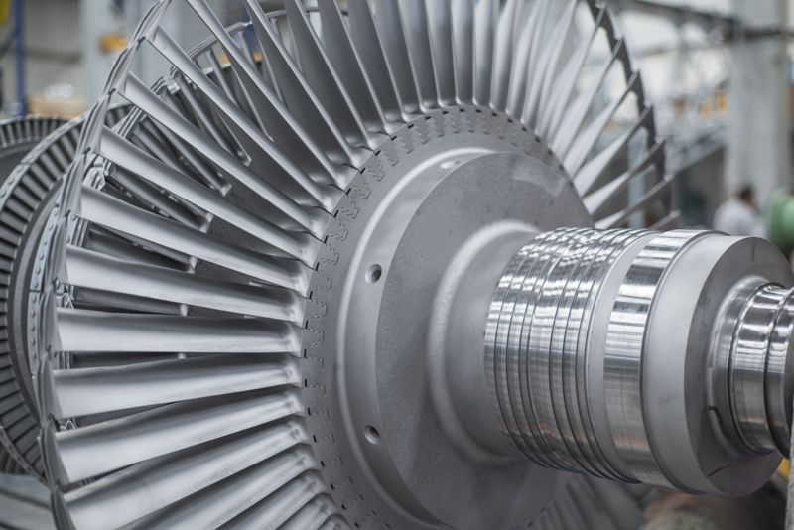
Barberton, OH
Engineering Focus:
Metals for aerospace, energy, construction
www.arconic.com

Slide 18
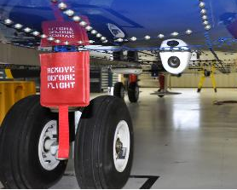
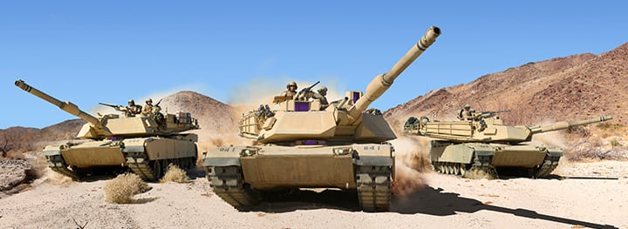
Akron, OH
Engineering Focus: Aerospace - landing gear, security, defense
www.meggitt.com

Slide 19
Are you interested in engineering or manufacturing as a career?
Choose an engineering pathway offered at several high schools
Pursue an engineering degree at UA

